Slide 1

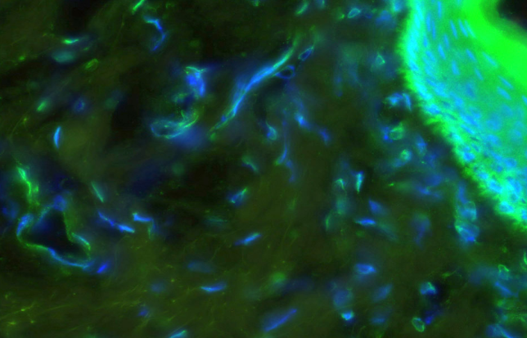
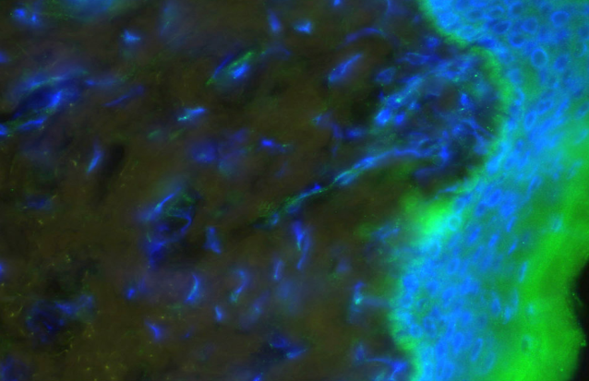
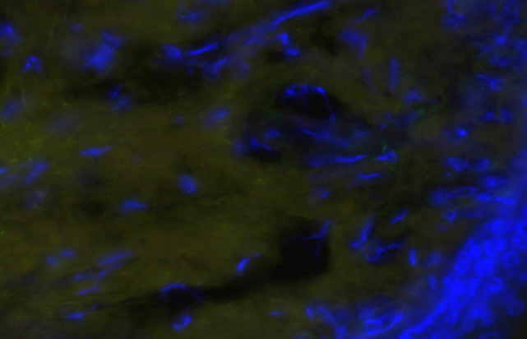
ReliaTech GmbH
Rabbit anti-human Endocan/ESM1
(Cat #102-PA44)
Immunofluorescence staining of cryo-sections of unfixed human foreskin with anti-human Endocan/EMS1 (dilution 1:100) [Cat# 102-PA44] and counter staining of nuclei with Dapi.
Note the specific green Endocan/ESM-1 signal in epidermis, connective tissue cells and vessels.
The experiment was performed by the research group of Prof. Dr. J. Wilting and Dr. K. Buttler, University Medicine Göttingen, Germany.
http://www.reliatech.de / orders@reliatech.de

